Slide 1


Vertical Farming
Aaron Curley
Yanchu Du
Richard Hamilton
Hunter Kea
Alfred Serventi

Slide 2
Overview
Project Problem
Solution Requirements
Solution
Design Approach
Design Comparisons
Customer/Engineering Requirements
Manufacturing Details
Testing Details
Budget
Future Work

Slide 3
Project Problem
The team wanted to create an indoor consumable plant growing system with a small footprint & high yield of crops.
Most growing solutions can only grow a few plants at a time or require large amounts of space and soil.
This solution is ideal for those that already own large fish tanks however it can be done without owning them already.

Slide 4
Solution Requirements
Residential use
  1800 W from one outlet maximum
Minimal space requirements
  8ft tall maximum
  2ft deep maximum
Produce fresh fruits and vegetables at a reasonable cost
  Not trying to compete with large business store prices
User friendly to assembly and care for

Slide 5
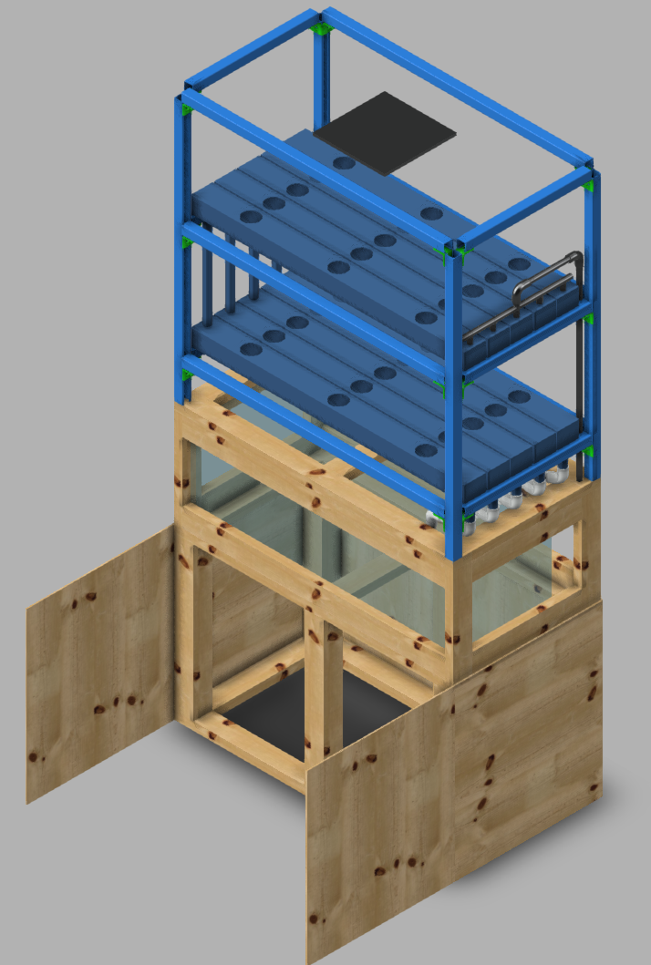
Solution
Final prototype design
Uses aquaponics to produce maximum amount of food with least concern about plant nutrition.
Minimal user intervention
Mostly self-sustaining
Aesthetically appealing system

Slide 6
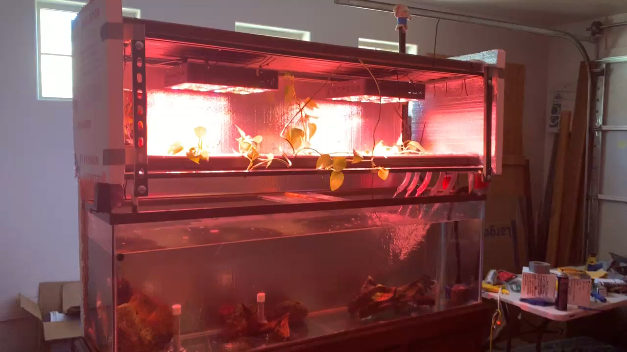
Proof of Concept Design Video

Slide 7
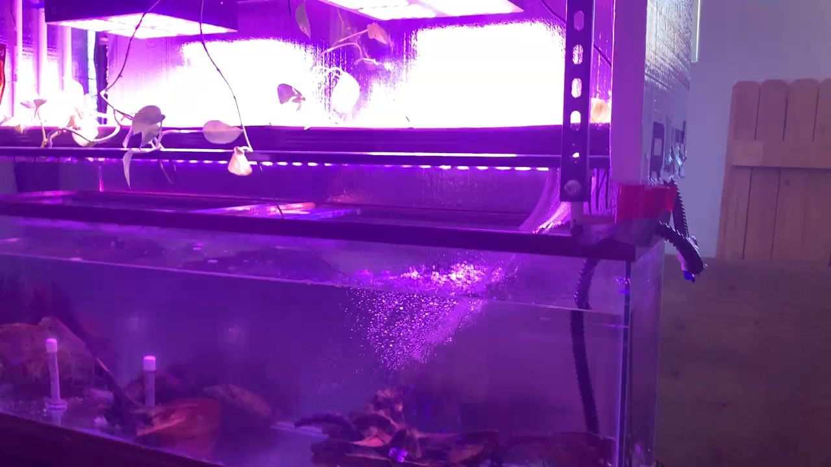
Proof of Concept Design Video Continued

Slide 8
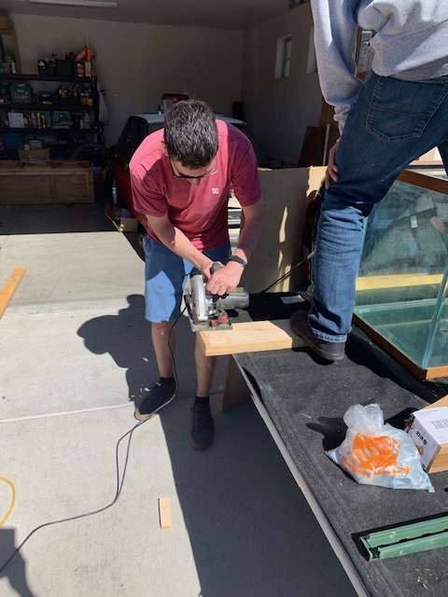
Design Creation
Decisions that led to final design
  Hydroponics system
    Nutrient Film Technique vs. Deep Water Culture vs. Aeroponics
  Lighting
    LED Vs HID
  Framing
    Unistrut vs. wood
  Building vs. purchasing stand
  Trough Style

Slide 9
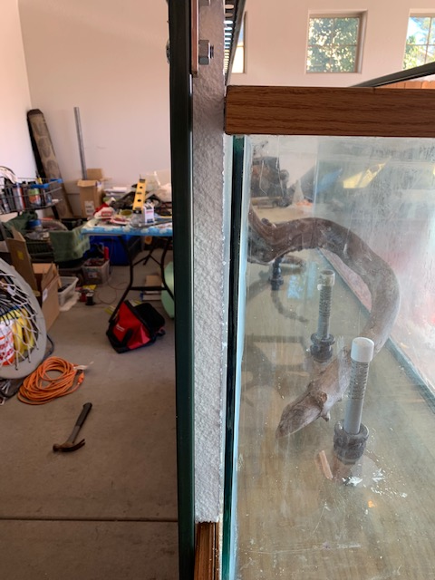
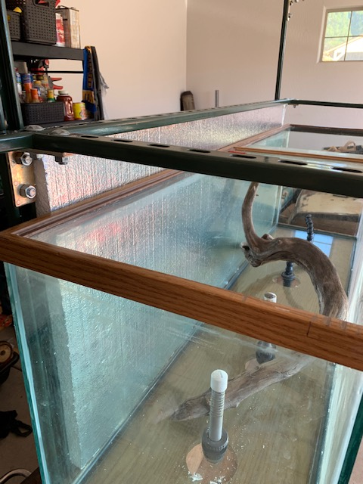
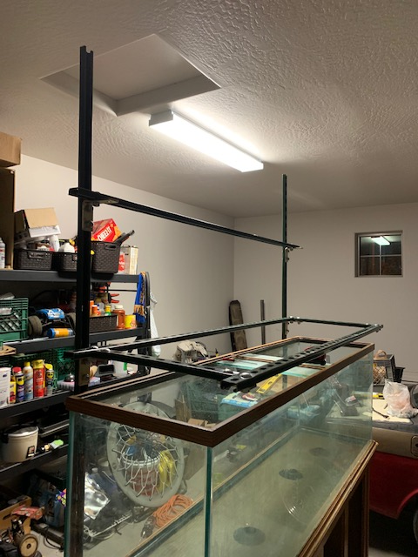
Design Creation

Slide 10
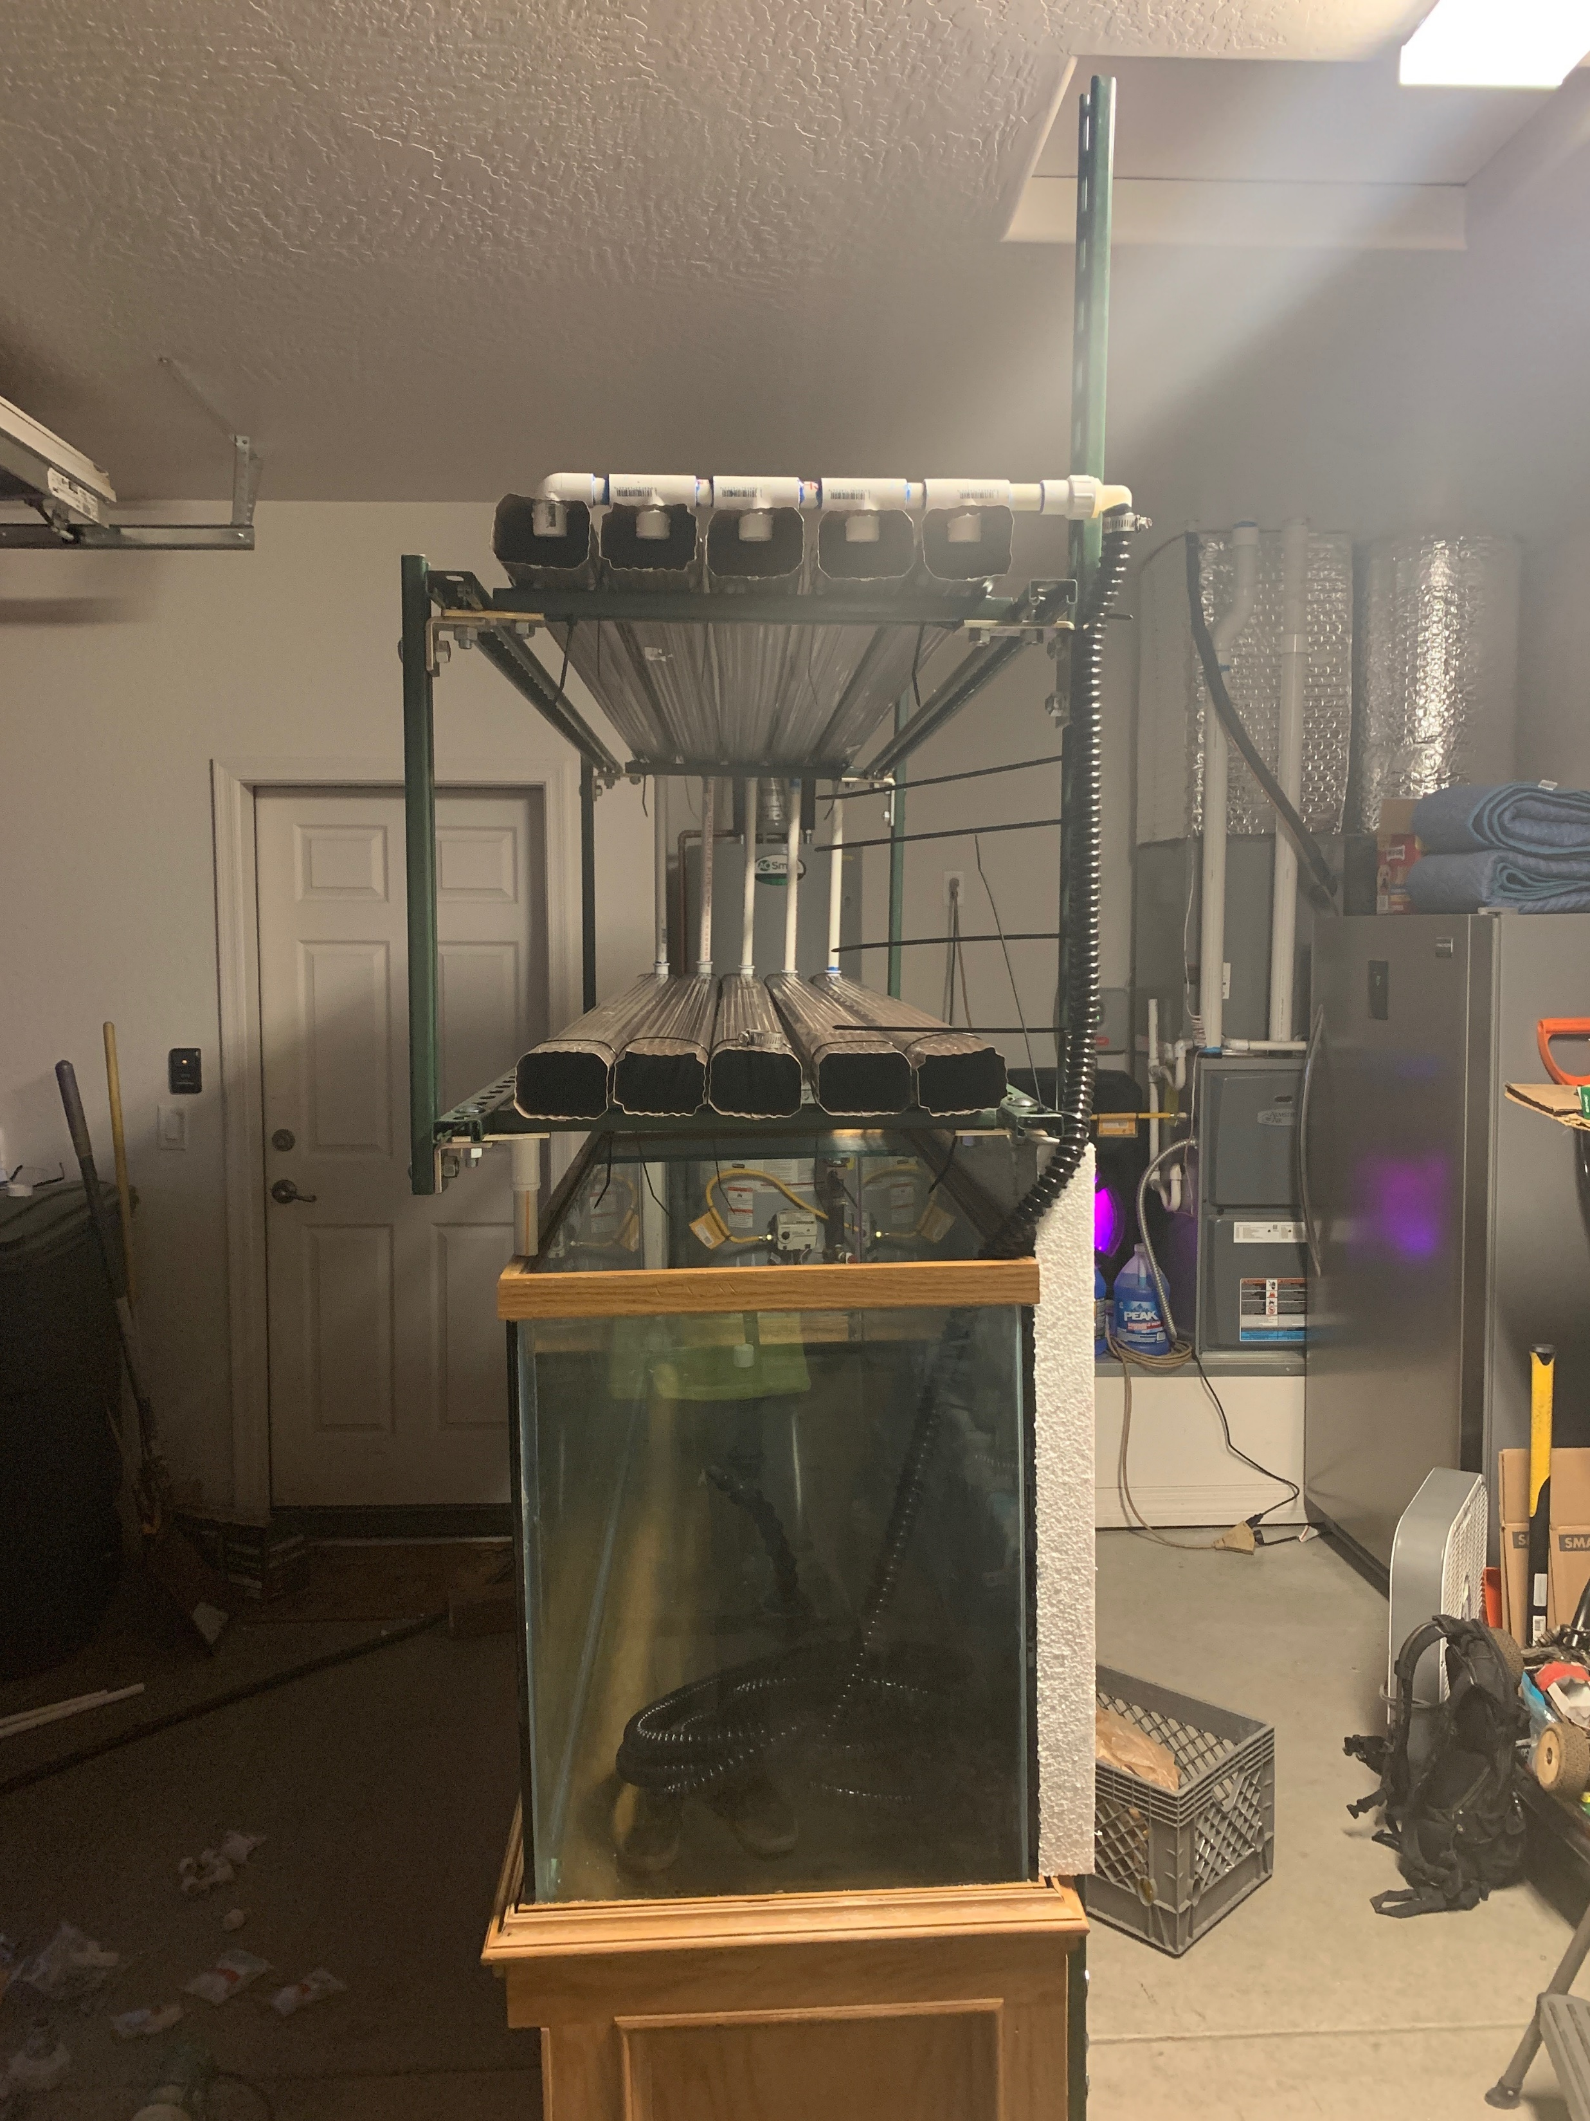
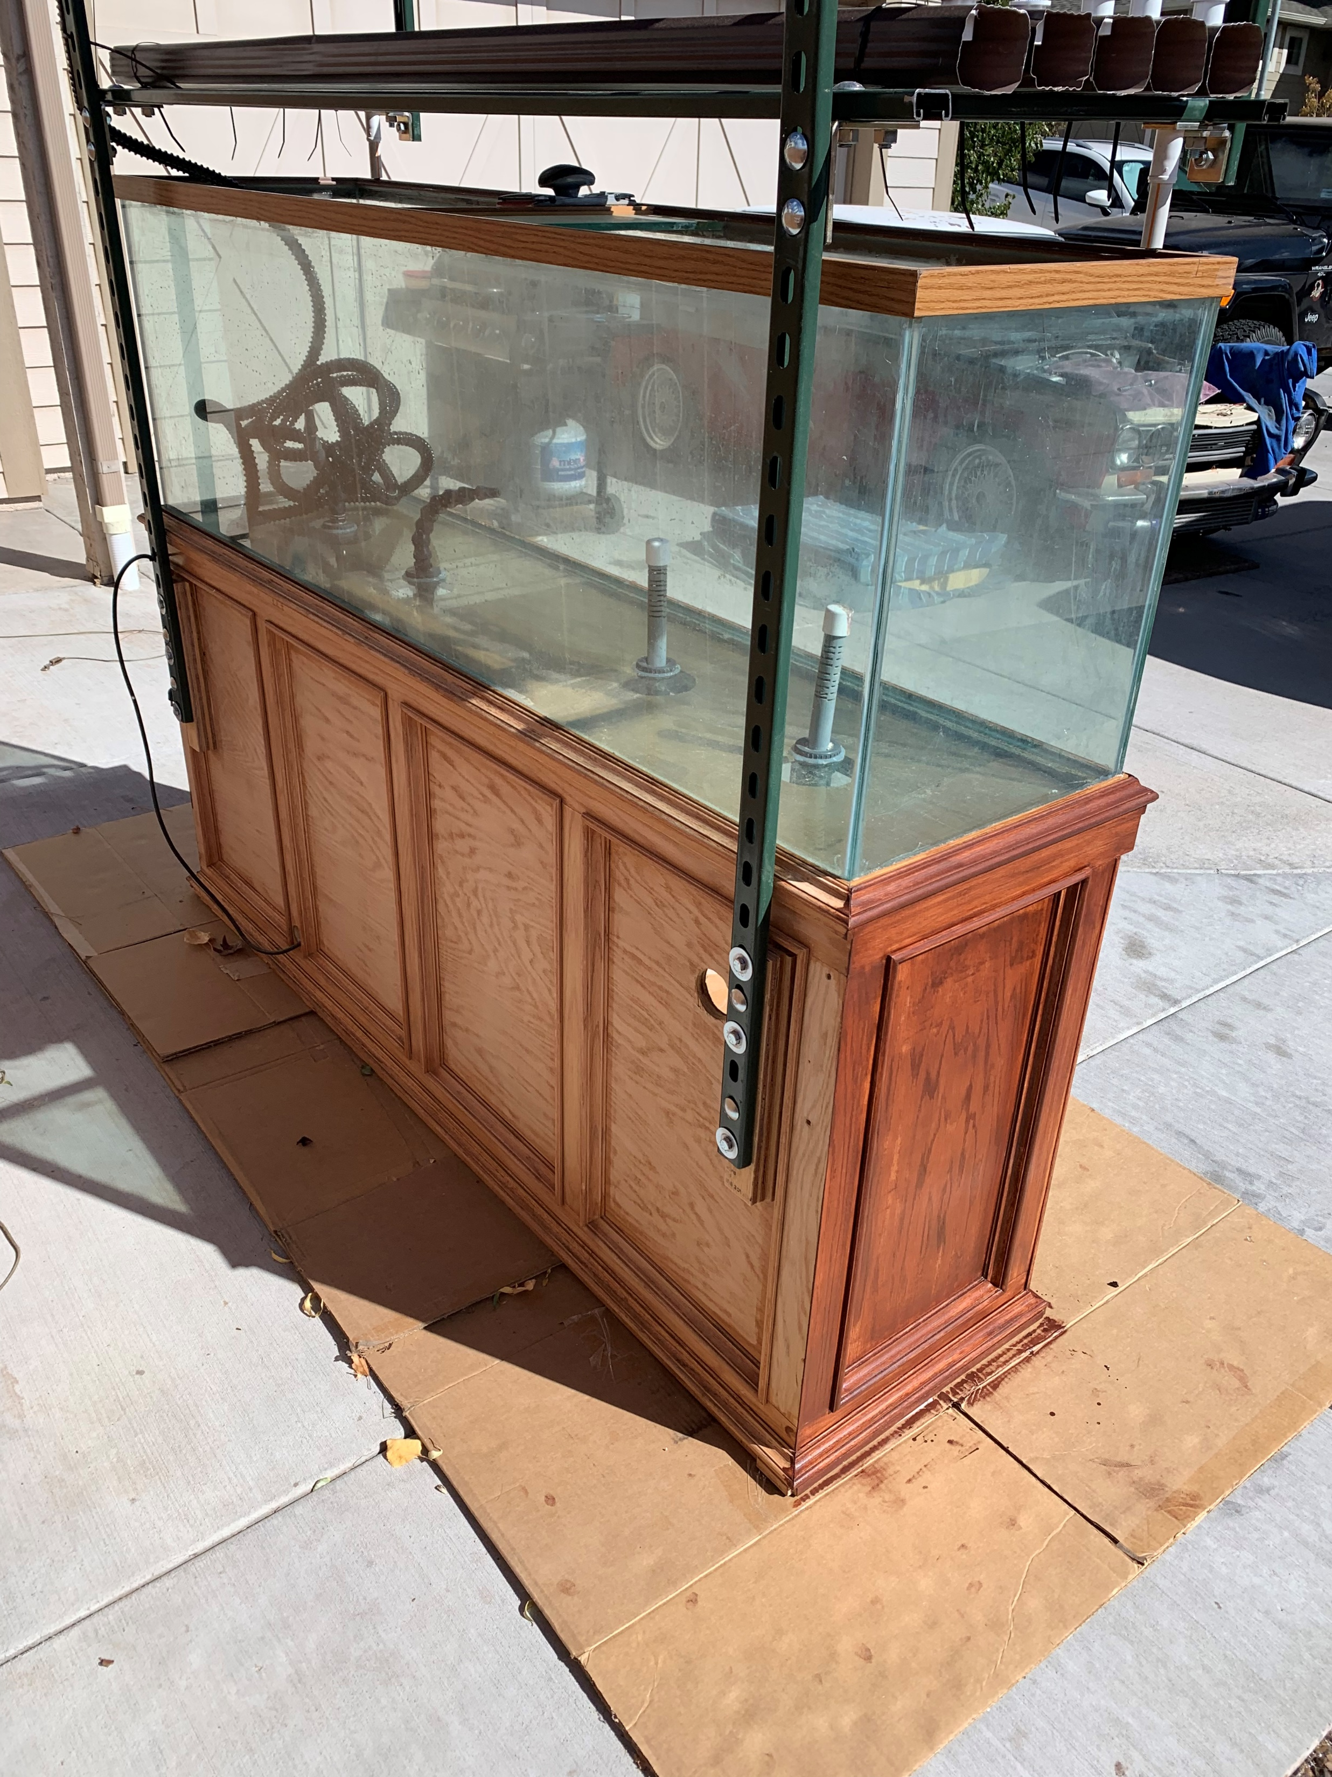
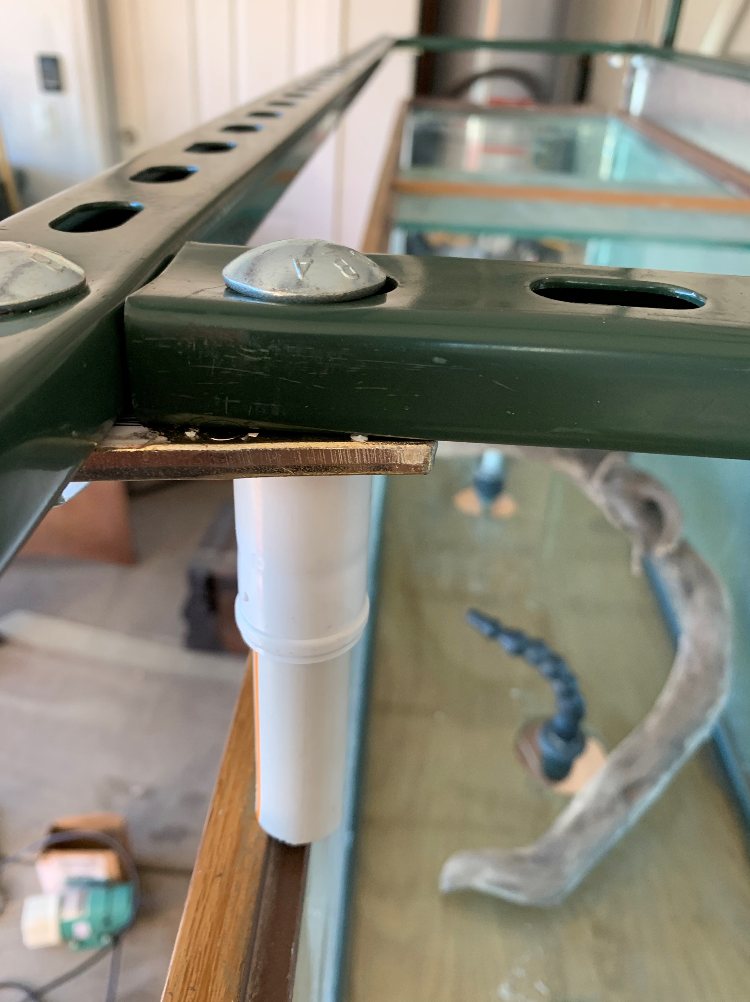
Design Creation

Slide 11
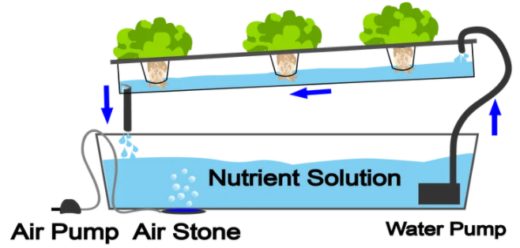
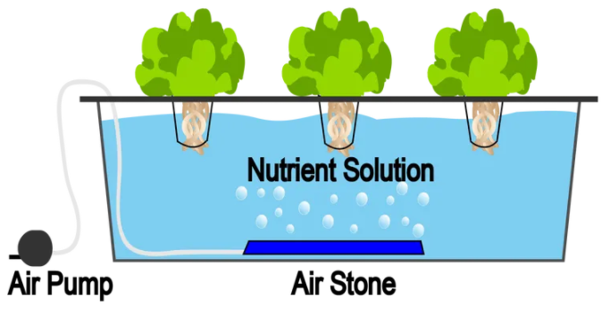
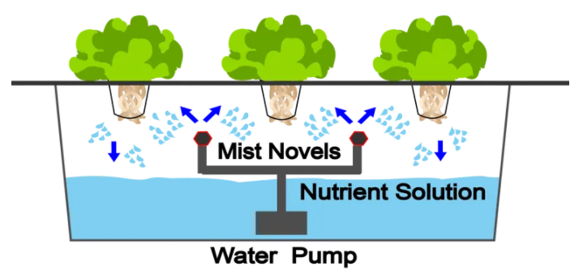
NFT vs DWC vs. Aeroponics for plants
Nutrient film technique
  Pros
    Space efficient
    Cascading water increases oxygen levels
  Con
    Water pump reliant
    Prone to clogging
Deep water culture
  Pros
    Inexpensive
    Simple/less parts to fail
    No water pump required
  Con
    Slow growth rate
    Risk of root rot
Aeroponics
  Pros
    Roots receive lots of oxygen
    Increased nutrient solution absorption
  Con
    Prone to clogging
    Water pump reliant
    Advanced/time intensive
    Expensive
[3]
[3]
[3]

Slide 12
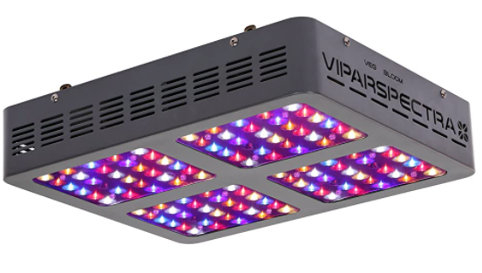
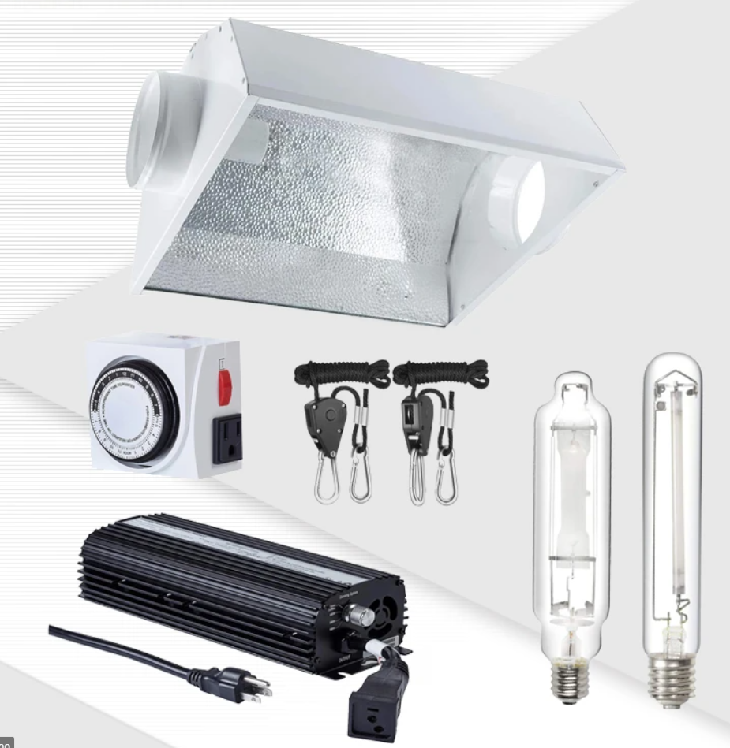
LED lights Vs High intensity discharge (HID)
LED
  Pros
    Lower heat generation
    No ballast required
    Color spectrum is easily adjusted
  Con
    Less powerful than HID
    Specifications not standardized
    High cost
HID
  Pros
    Low cost
    High intensity light
    Lots of information
  Con
    Quick bulb degradation
    Bulky
    Less control over spectrum
    Large amount of heat generated
[1]
[2]

Slide 13
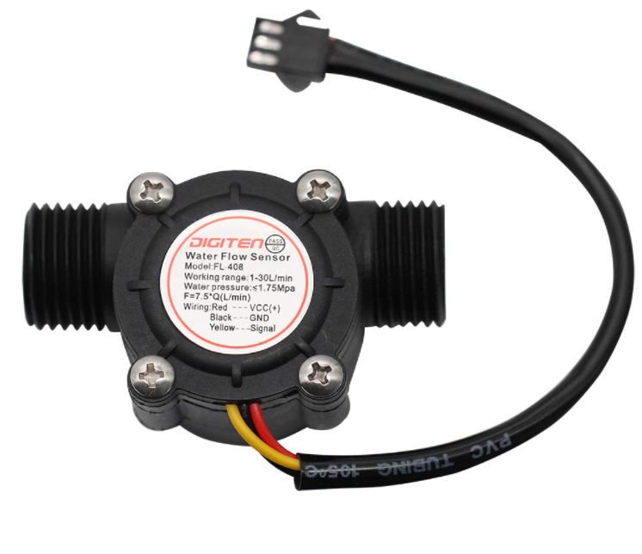
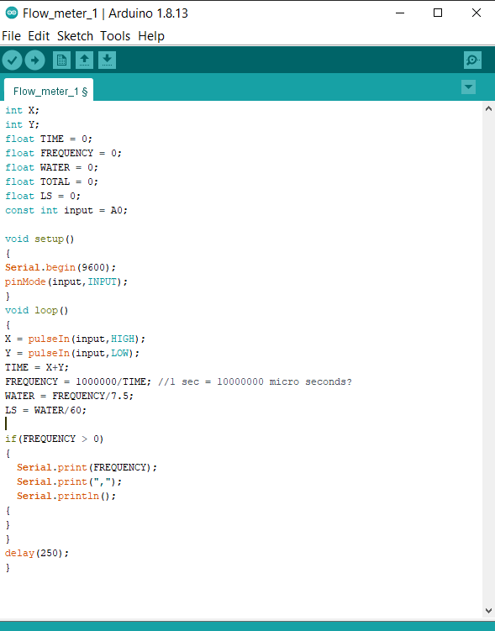
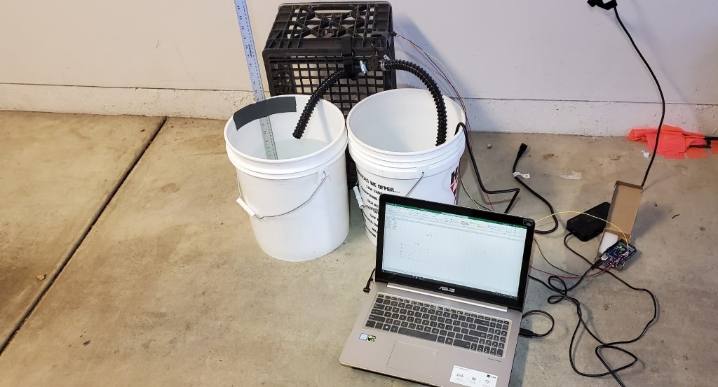
Flow meter calibration
Set up used to obtain calibration curve
Arduino Sketch

Slide 14
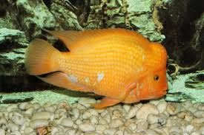
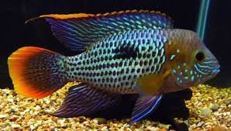
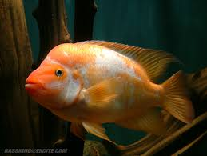
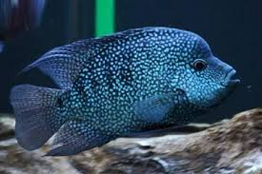
Fish – Central American Cichlids
The team had to use fish that were available because the budget was getting too tight
Fish are left to right top to bottom
Amphilophus Labiatus -"Red devil"
Andinoacara Rivulatus - "Green Terror"
Amphilophus Piebald - "Piebald Midas"
Herichthys Cyanoguttatus - "Texas Cichlid"

Slide 15
Customer requirements/Engineering requirements
Customer Requirements | Target Engineering Requirements
Sufficient lighting | 200 PPFD
Maintain proper nutrient solution basicity automatically | 6.8 - 7.2 PH
Maintain water temperature | 68°F-74°F
Support fish tank weight | Support 1300 lbs
Adequate flow rate | 28 GPH
Minimal electrical operating cost | ~$60 per month
Small footprint | 8 ft²
Quiet | 55 Decibels
Monitor flow rate | Alert @ flow rate < 5 GPH
Customer requirements not met
  Small footprint
  Sufficient lighting
  Minimal electrical operating cost
  Operation noise
  Maintain proper nutrient solution basicity automatically

Slide 16
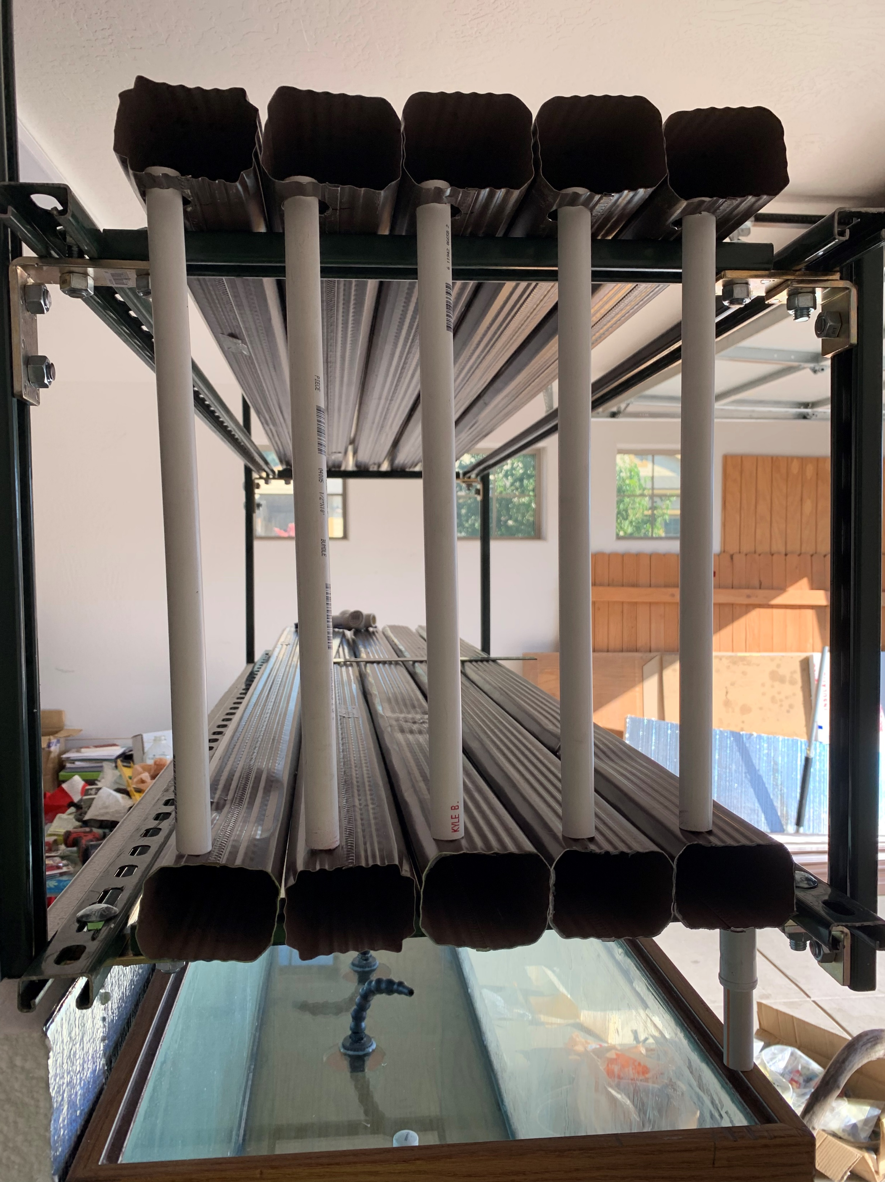
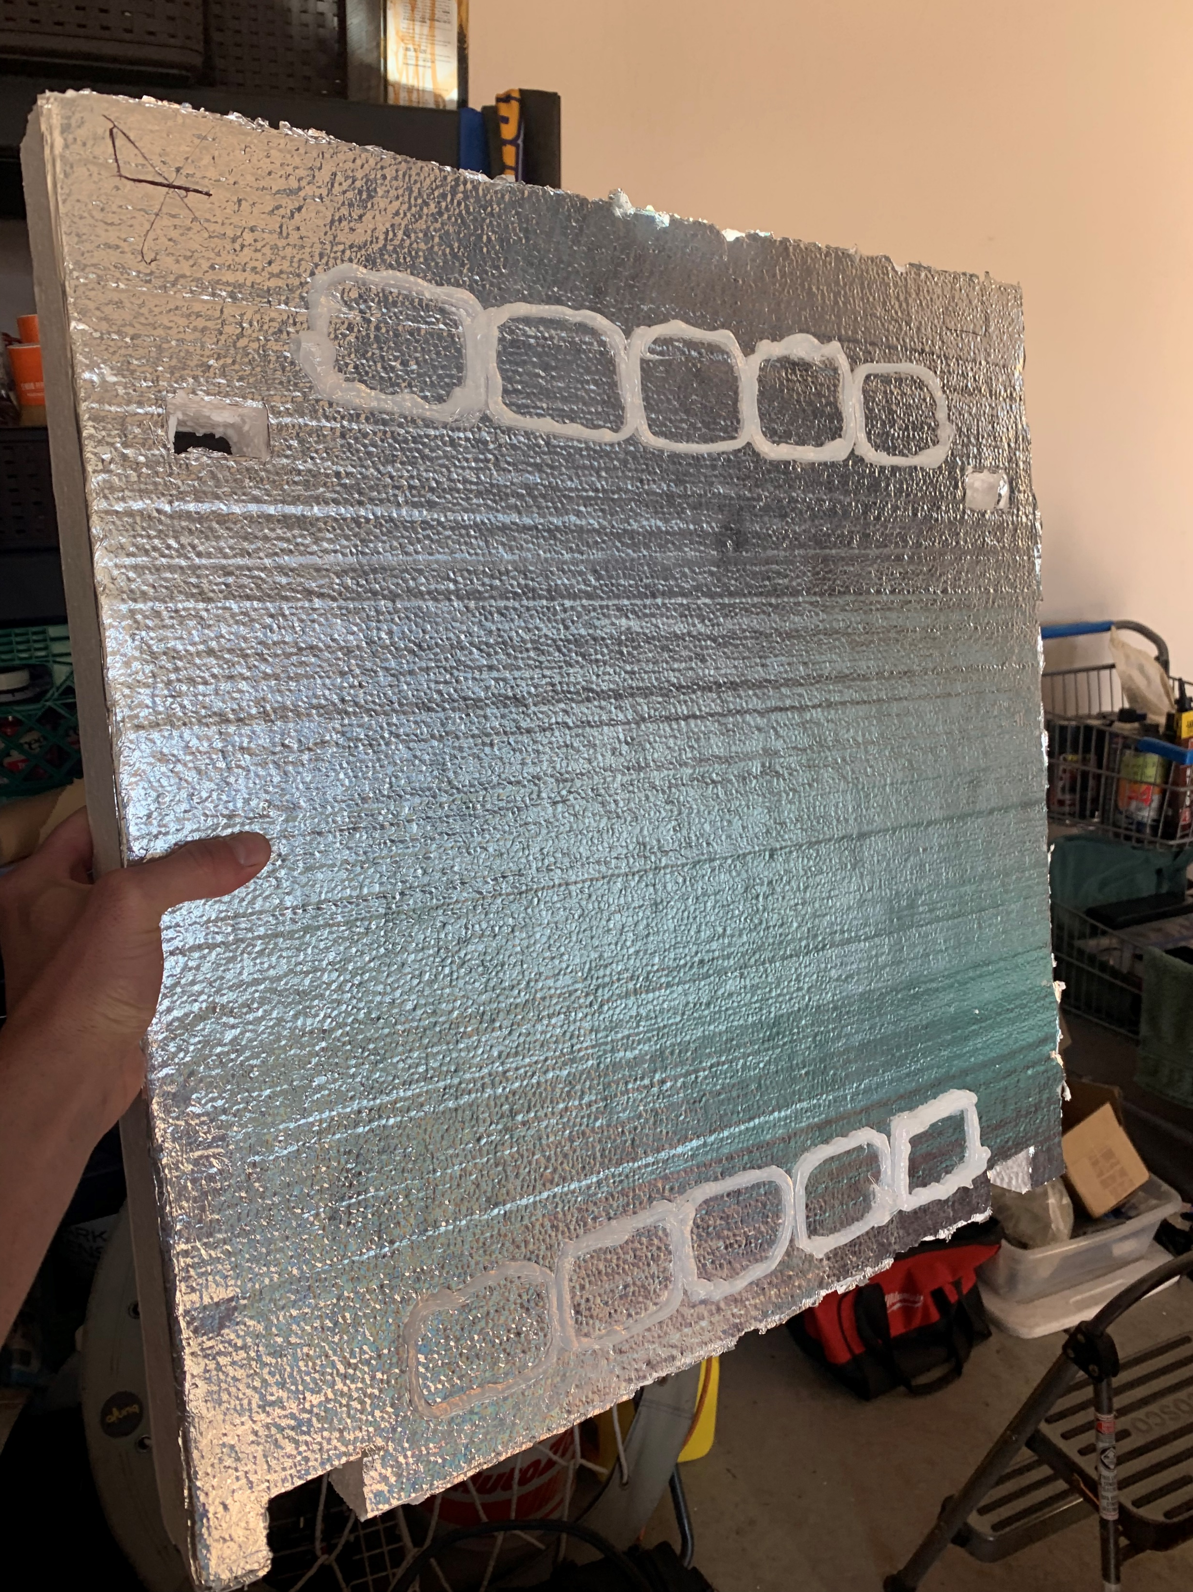
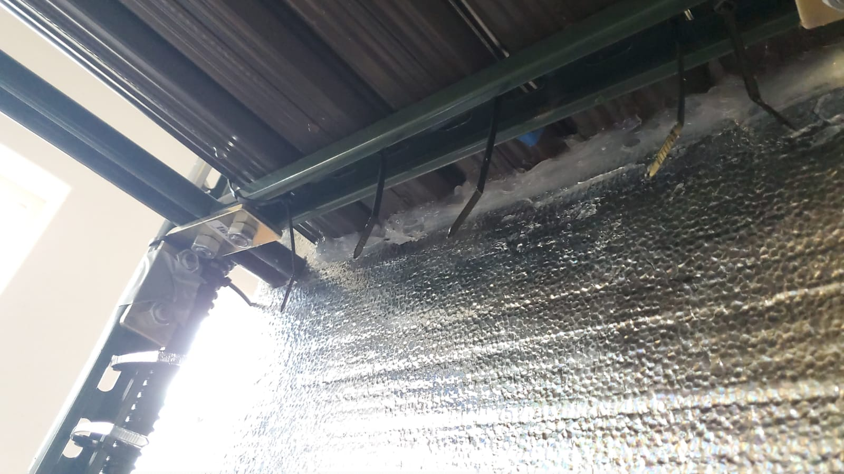
Manufacturing Obstacles
Capping the troughs so the water would not drain out was a large hurdle for the team. The original 3D printed endcaps did not fit well and did not seal properly. The team ended up using the insulation to not only cap the troughs but reflect light back into the tank and growing area.

Slide 17
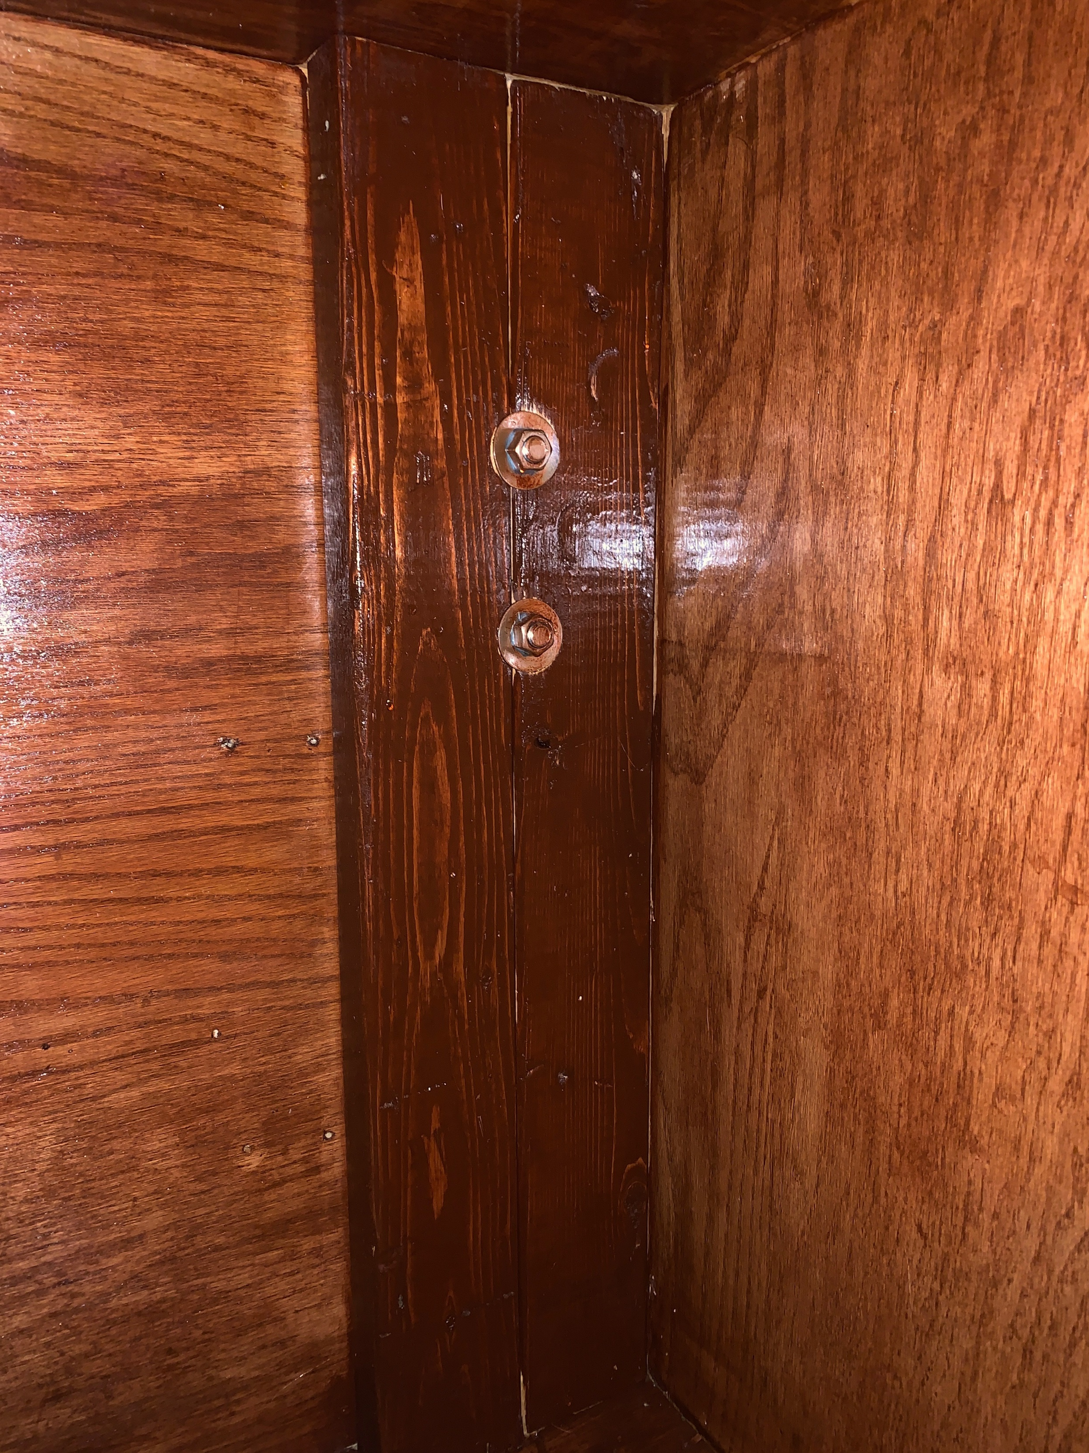
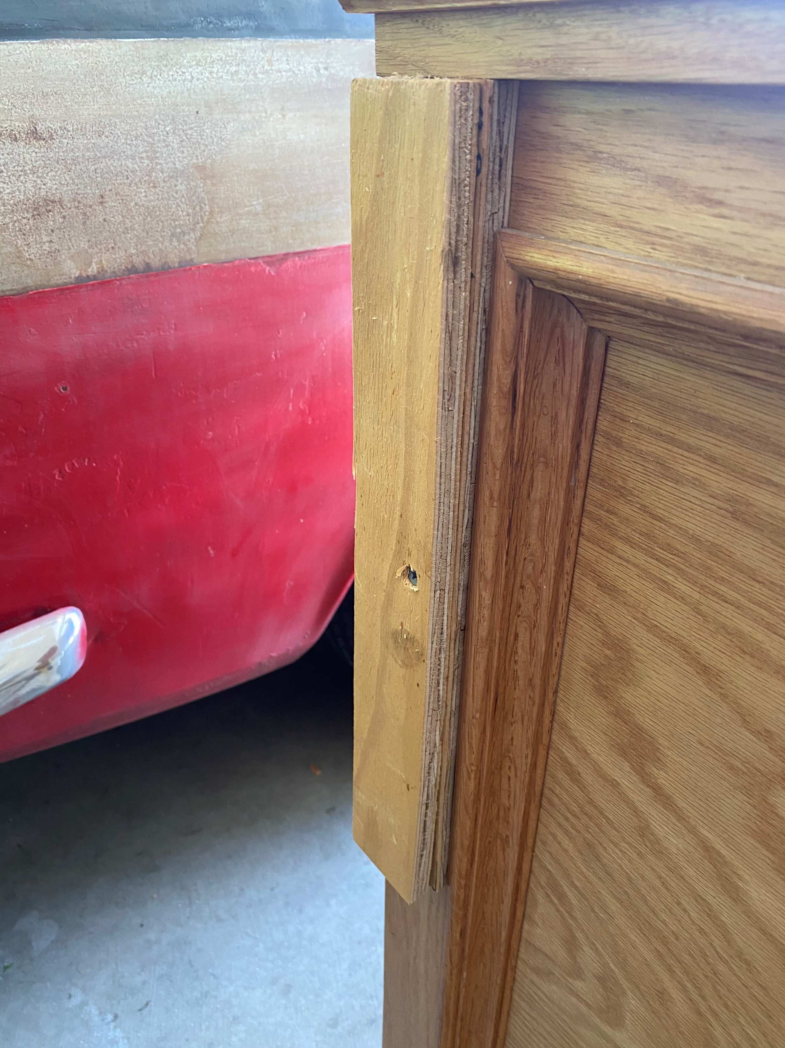
Manufacturing
Another large obstacle was the mounting of the Unistrut. The team wanted to make sure that the framing was stable and weight capable when installed. We opted to reinforce the tank stand with extra 2x4 pieces of wood to screw into.

Slide 18
Testing
Leak test
  Fish tank
  Troughs
  Ensure minimal leaking in system. Leaks into the tank are acceptable
Load test
  Filled troughs and tank with water
  Structural components did not break or deform
Test water temperature
  Consistent water temperature over a few day period
Test sound levels with phone app

Slide 19
Budget
Discounts
Markdowns
Avoided shipping fees when possible
Used personal excess materials

Slide 20
Future work
Improve grow through system
  Have pre-cut, watertight troughs for various tank sizes.
Improve water drainage system
Add mounting for top level lighting
Buy and install equipment for monitoring water PH, electrical conductivity, and oxygen levels
Buy meter to measure electricity usage
Buy PAR meter to measure photon flux density of PAR light at plant canopy

Slide 21
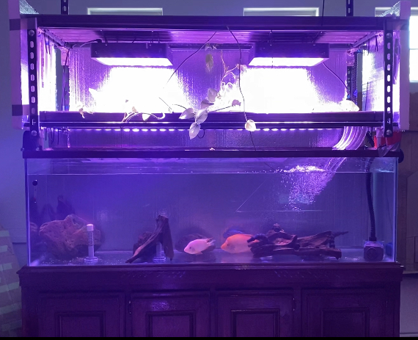
Questions?

Slide 22
References
[1] https://www.amazon.com/VIPARSPECTRA-Reflector-R900-Spectrum-Indoor/dp/B019ETLC7M?th=1
[2] https://www.google.com/imgres?imgurl=https%3A%2F%2Fcdn.shopify.com%2Fs%2Ffiles%2F1%2F0037%2F1861%2F0990%2Fproducts%2F28_2048x.jpg%3Fv%3D1597743584&imgrefurl=https%3A%2F%2Fwww.growpackage.com%2Fcollections%2Feco-farm-hps-mh-grow-lights&tbnid=HEHD9zlSenOdlM&vet=10COgBEDMozQFqFwoTCPjh0qrrhe0CFQAAAAAdAAAAABAD..i&docid=-yWEz8mxTnz5JM&w=800&h=800&q=hid%20grow%20lights&ved=0COgBEDMozQFqFwoTCPjh0qrrhe0CFQAAAAAdAAAAABAD
[3] https://www.nosoilsolutions.com/6-different-types-hydroponic-systems/

